Slide 1
the new DTI Customer Request Portal
ServiceNow
DelDOT Portal Retiring

Slide 2
DelDOT Portal Being Retired DelDOT Onboarding & other services migrated to DTI’s Customer Request portal
Project Overview
Out of the Box Benefits (6)
When does this go into effect into ServiceNow?
When does this effect DelDOT?
Where does DelDOT find their Onboarding?
Where does DelDOT report an Issue?
When is the project fully completed?
What is next for DTI?

Slide 3
Project Overview
Currently ServiceNow In an extremely customized land
Not using standard ticket structure
Inconsistent user experience
Complex and custom security roles
Customized order process
Currently ServiceNow processes Slow to Market
Months to Years (dependent on complexity)
Currently can’t take advantage of all the new features released with upgrades
Currently Expensive to Create new processes or maintain processes
FYI for DelDOT
ServiceNow Request Management module is now less customed and now more out of the box; with that:
DelDOT’s Portal is Retiring due to being highly customized
DelDOT’s Onboarding and Issue reporting now on DTI’s Customer Request Portal
DTI as the centralized IT organization for the State of Delaware is providing one consistent portal for all their customer needs.

Slide 4
Benefits of moving to one Consistent Portal
Improved end user experience
Enables the service catalog to be structured to provide an online shopping cart experience
Improved DTI internal processes for increased efficiency
Consolidates similar processes such as reducing 10 security input forms (process requests) to 3 security input forms (process requests)
Increased usage of self-service through the Portal
Decreases the dependency on the ServiceDesk
Reduces fulfillment times for requested items
Improved communication about DTI services and products
Increases utilization of the Portal and the Service Now Catalog
Increased user involvement with the creation and maintenance of ServiceNow components
More DTI team and product manager empowerment
Reduced costly ServiceNow customizations

Slide 5
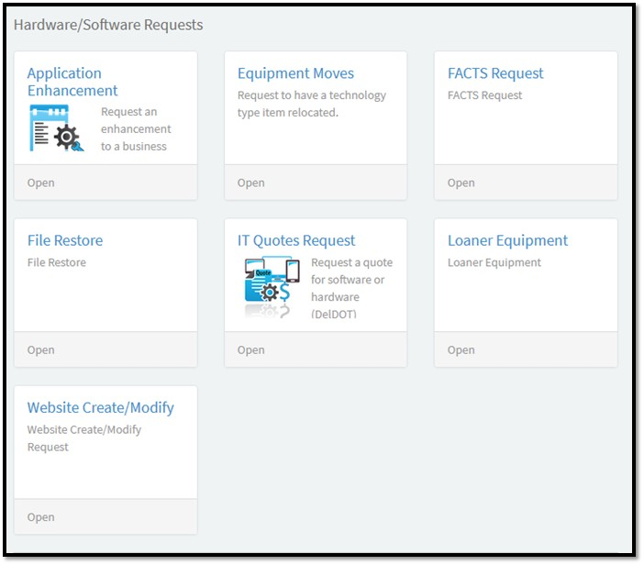
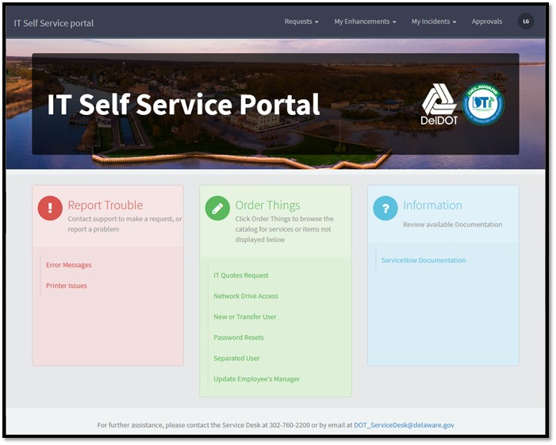
On August 21, 2020 DTI will be retiring DelDOT’s ServiceNow portal

Slide 6
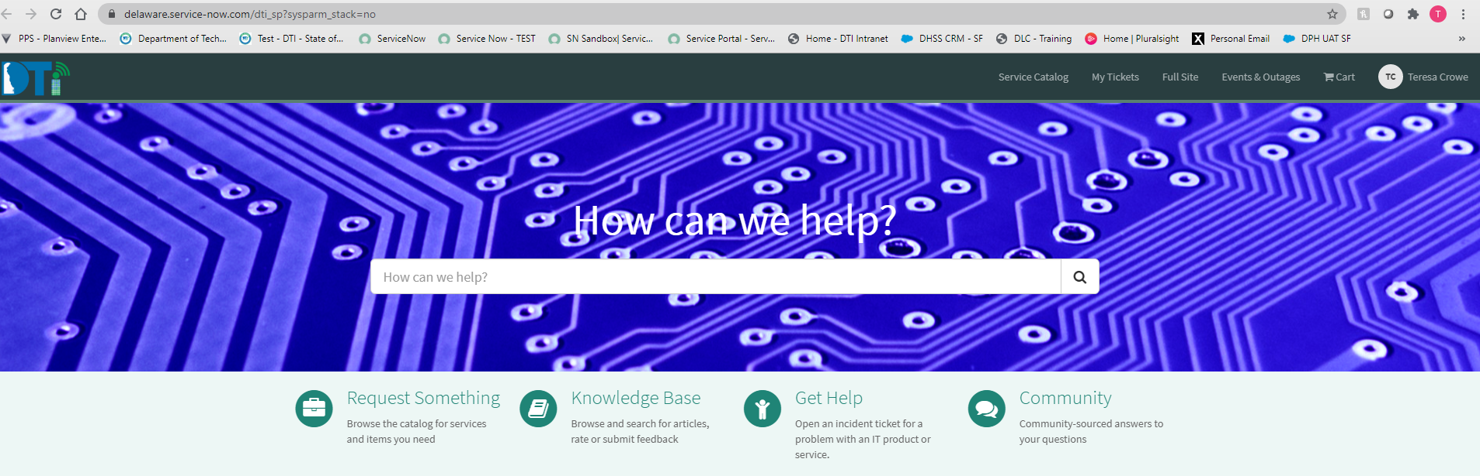
On August 24, 2020 – DelDOT will be using DTI’s Customer Request Portal for all services including IT onboarding.
https://delaware.service-now.com/dti_sp?sysparm_stack=no
https://delaware.service-now.com/dti_sp?sysparm_stack=no

Slide 7



DTI’s Customer Request Portal
Need request access or application enhancements
Use Request Something on the Portal
Need to report an issue to DTI
Use Get Help on the Portal
Can’t find what you’re looking for or short on time to explore
Use the Search bar on the Portal

Slide 8
DTI Next Steps:
What’s Next for DTI?
Doing more ServiceNow modules from customized to out of the box.
Next module is Incident Management.
Scheduled to start in Fall 2020
Things to Remember for Right Now
8/21 – DelDOT portal going away
8/24 – DelDOT uses DTI’s Customer Request Portal for IT products and services including IT Onboarding.

Slide 9

Have any questions? Please reach out to the ServiceNow project manager at Terri.Crowe@delaware.gov.

